Slide 1
Session 05
Circular Linked List – Create & Display

Slide 2
Circular Linked List - Creation
A new node is created with data and next field initialize to a value and null.
It first checks whether the head is null, then it will insert the node as the head.
Both head and tail will point to the newly added node.
If the head is not null, the new node will be the new tail, and the new tail will point to the head as it is a circular linked list.

Slide 3
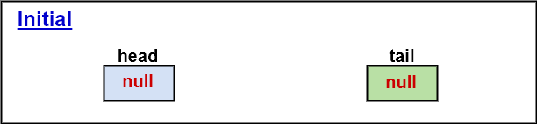
Circular Linked List - Creation

Slide 4
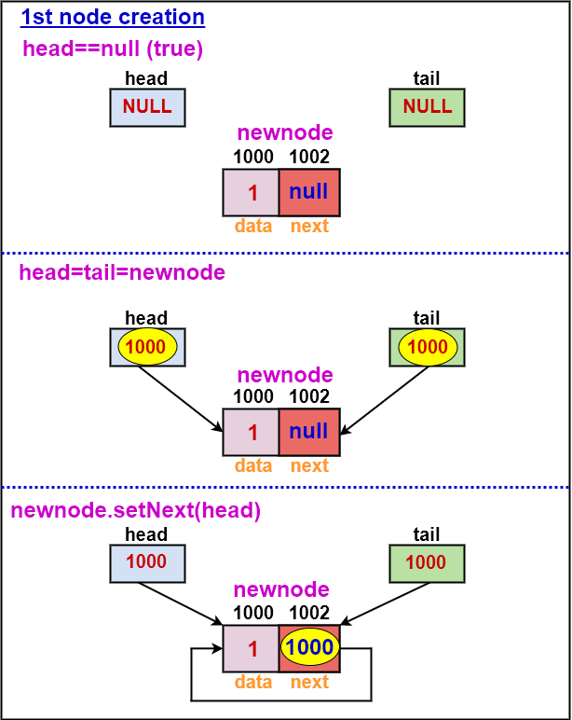
Circular Linked List - Creation

Slide 5
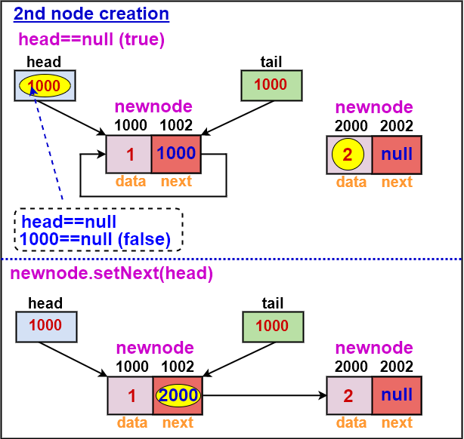
Circular Linked List - Creation

Slide 6
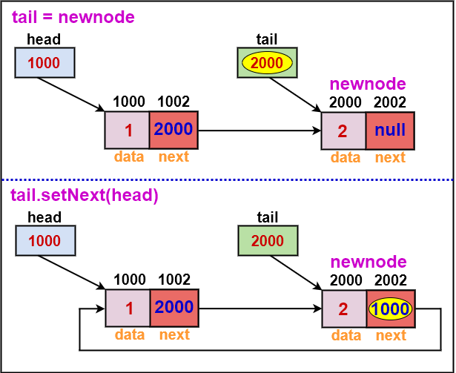
Circular Linked List - Creation

Slide 7
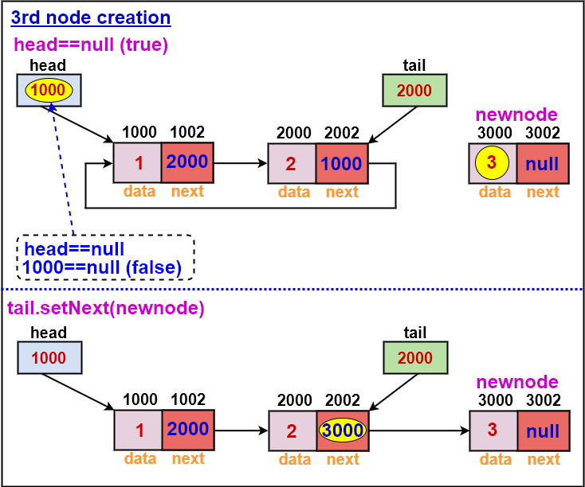
Circular Linked List - Creation

Slide 8
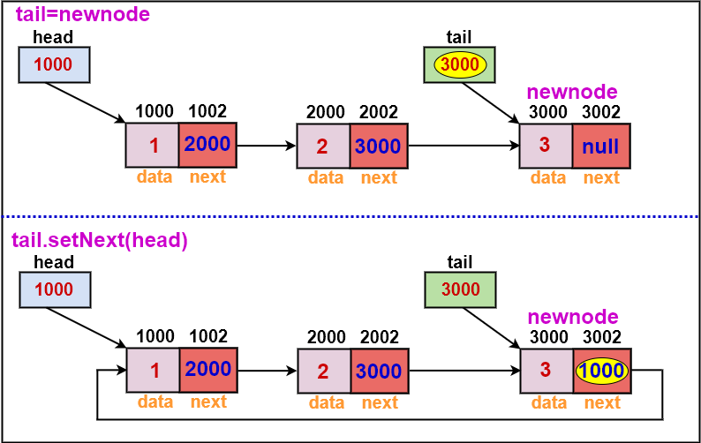
Circular Linked List - Creation

Slide 9
Circular Linked List - Display
Define a new node 'current' that will point to the head.
Print current.data till current will points to head
Current will point to the next node in the list in each iteration.

Slide 10
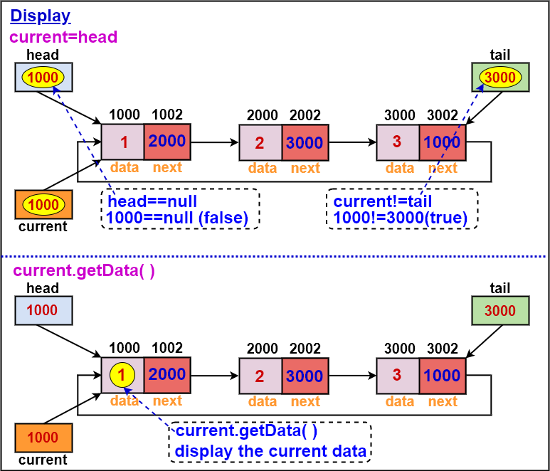
Circular Linked List - Display

Slide 11
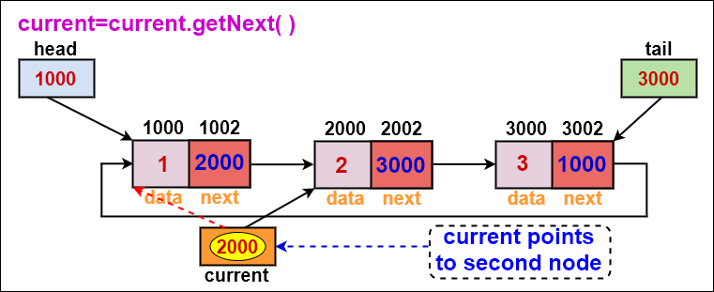
Circular Linked List - Display

Slide 12
THANK
YOU

